Slide 1
International Finance
Lecture: Alexander Borochkin

Slide 2
Unit 1. The Foreign Exchange Market
1.1. Foreign Exchange Market definition
1.2. Understanding currency quote
1.3. Russian foreign exchange market
1.4. Currency Arbitrage
1.5. Short-term and Long-term Foreign Exchange Movements
1.6. Trade-weighted Exchange Rate Indexes

Slide 3
1.1. Foreign Exchange Market definition
The foreign exchange market is a place where large commercial banks trade foreign-currency-denominated deposits with each other

Slide 4
Global foreign exchange market turnover, daily averages in billions of US dollars and percentages
Instrument | 1998 | 2001 | 2004 | 2007 | 2010 | 2013
Foreign exchange instruments | 1527 | 1239 | 1934 | 3324 | 3971 | 5345
Spot transactions | 37% | 31% | 33% | 30% | 37% | 38%
Outright forwards | 8% | 10% | 11% | 11% | 12% | 13%
Foreign exchange swaps | 48% | 53% | 49% | 52% | 44% | 42%
Currency swaps | 1% | 1% | 1% | 1% | 1% | 1%
Options and other products | 6% | 5% | 6% | 6% | 5% | 6%
Source: Bank for International Settlements. Triennial Central Bank Survey. Report on Global Foreign Exchange Market Activity in 2013. Basel, December, 2013

Slide 5
Global forex market turnover by currency pair, daily averages in billions of USD and %
Currency pair | 2001 |  | 2007 |  | 2013
 | Amount | % | Amount | % | Amount | %
USD / EUR | 372 | 30,0 | 892 | 26,8 | 1 289 | 24,1
USD / JPY | 250 | 20,2 | 438 | 13,2 | 978 | 18,3
USD / GBP | 129 | 10,4 | 384 | 11,6 | 472 | 8,8
USD / AUD | 51 | 4,1 | 185 | 5,6 | 364 | 6,8
USD / CAD | 54 | 4,3 | 126 | 3,8 | 200 | 3,7
USD / CHF | 59 | 4,8 | 151 | 4,5 | 184 | 3,4
USD / OTH | 199 | 16,0 | 612 | 18,4 | 213 | 4,0
EUR / JPY | 36 | 2,9 | 86 | 2,6 | 147 | 2,8
EUR / GBP | 27 | 2,1 | 69 | 2,1 | 102 | 1,9
EUR / CHF | 13 | 1,1 | 62 | 1,9 | 71 | 1,3
EUR / OTH | 20 | 1,6 | 83 | 2,5 | 52 | 1,0
All currency pairs | 1 239 | 100,0 | 3 324 | 100,0 | 5 345 | 100,0
Source: Bank for International Settlements. Triennial Central Bank Survey. Report on Global Foreign Exchange Market Activity in 2013. Basel, December, 2013

Slide 6
Geographical distribution of global forex market turnover, 2 daily averages in billions of USD and %
Country | 2004 |  | 2010 |  | 2013
 | Amount | % | Amount | % | Amount | %
United Kingdom | 835 | 32,0 | 1 854 | 36,8 | 2 726 | 40,9
United States | 499 | 19,1 | 904 | 17,9 | 1 263 | 18,9
Singapore | 134 | 5,1 | 266 | 5,3 | 383 | 5,7
Japan | 207 | 8,0 | 312 | 6,2 | 374 | 5,6
Hong Kong SAR | 106 | 4,1 | 238 | 4,7 | 275 | 4,1
Switzerland | 85 | 3,3 | 249 | 4,9 | 216 | 3,2
Total | 2 608 | 100,0 | 5 043 | 100,0 | 6 671 | 100,0
Source: Bank for International Settlements. Triennial Central Bank Survey. Report on Global Foreign Exchange Market Activity in 2013. Basel, December, 2013.

Slide 7
1.2. Understanding currency quote
When a currency is quoted, it is done in relation to another currency, so that the value of one is reflected through the value of another.
USD/JPY = 102.50.
The base currency is set to the left of the slash, while the currency on the right is referred to as the quote or counter currency

Slide 8
Direct and indirect quote
In a direct currency quote the domestic currency is the base currency. The direct quote varies the foreign currency, and the quoted, or domestic currency, remains fixed at one unit.
In an indirect quote the domestic currency is the quoted currency. The domestic currency is variable and the foreign currency is fixed at one unit.

Slide 9
U.S. dollar as a base currency in the currency pair.
The Queen's currencies: the British pound, Australian Dollar and New Zealand dollar - are all quoted as the base currency against the U.S. dollar. The euro is quoted the same way as well.

Slide 10

Example of the currency quotes
Most currency exchange rates are quoted out to five digits after the decimal place, with the exception of the Japanese yen (JPY), which is quoted out to three decimal places

Slide 11
When a currency quote is given without the U.S. dollar as one of its components, this is called a cross currency. The most common cross currency pairs are the EUR/GBP, EUR/CHF and EUR/JPY.

Slide 12
Bid and Ask price
When buying a currency pair (going long), the ask price refers to the amount of quoted currency that has to be paid in order to buy one unit of the base currency, or how much the market will sell one unit of the base currency for in relation to the quoted currency.
When selling a currency pair (going short) the bid price reflects how much of the quoted currency will be obtained when selling one unit of the base currency, or how much the market will pay for the quoted currency in relation to the base currency.

Slide 13
Whichever currency is quoted first (the base currency) is always the one in which the transaction is being conducted. Operator either buys or sells the base currency.

Slide 14
Spread, pips and points
The difference between the bid price and the ask price.
EUR/USD = 1.25155/035, the spread would be 0.00035 or 35 pips, also known as points.
The pip is the smallest amount a price can move in any currency quote. In the case of the U.S. dollar, euro, British pound or Swiss franc, one pip would be 0.00001. With the Japanese yen, one pip would be 0.001, because this currency is quoted to two decimal places.

Slide 15
1.3. Russian foreign exchange market
Moscow Exchange Group (http://moex.com) is a rouble liquidity centre and the oldest regulated domestic FX trading venue, operating since 1992.
The Central Bank of the Russian Federation sets the official RUB exchange rate based on exchange trading results.
FX Market members post full or partial collateral to execute their trades.
Trades are settled on a payment vs. payment basis, whereby delivery is made when a member fulfils all of its obligations to the the National Clearing Centre (NCC) which acts as the central counterparty and is responsible for centralised clearing.

Slide 16
Moscow Exchange offers trading in the following currencies:
U.S dollar (USD), euro (EUR), U.S. dollar-euro basket (BKT), Chinese yuan (CNY), Ukrainian hryvnia (UAH), Kazakh tenge (KZT), and Belarusian ruble (BYR), with settlement in Russian rubles (RUB).
Euro with settlement in U.S. dollars.
In 2013 spot trades totalled RUB 57 trln and swap trades amounted to RUB 99 trln.

Slide 17
1.4. Currency Arbitrage
Currency arbitrage is the practice of taking advantage of exchange rates difference between two or more markets.
Arbitrage opportunity for USD/CHF:
Citibank is quoting 0.8745-55.
Deutsche Bank is quoting 0.8725-35.
Trader could buy $ 10 million at Deutsche Bank’s offer price of 0.8735 and simultaneously sell $ 10 million to Citibank at their bid price of 0.8745 francs. This would earn a profit of SF0.0010 per dollar traded, or SF10,000 would be the total arbitrage profit.

Slide 18
1.5. Short-term and Long-term Foreign Exchange Movements
Causes of short-term (throughout the day) FX movements:
inventory control;
asymmetric information effects.
In the long run, economic factors affect the exchange rate movements:
demand/ supply of foreign and domestic goods);
Government policy change;
Economic growth and inflation.

Slide 19
1.6. Trade-weighted Exchange Rate Indexes
An exchange rate index is a weighted average of a currency’s value relative to other currencies, with the weights typically based on the importance of each currency to international trade.
The Russian Central Bank calculates the value dual-currency busket as the sum of rouble values of 0.55 US dollars and 0.45 euros. The rouble value of the dual-currency basket has been the operational indicator of the Bank of Russia exchange rate policy since February 2005.

Slide 20
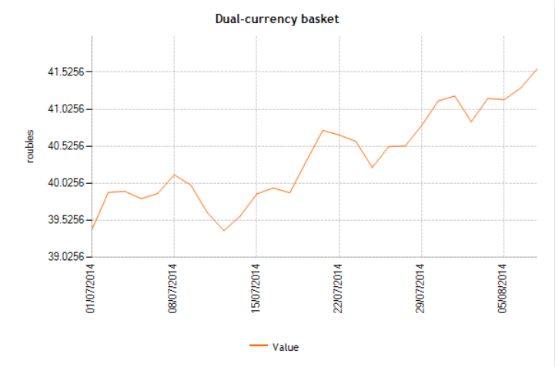
The values of the dual currency basket calculated by The Central Bank of Russian Federation. Source: The Central Bank of Russian Federation. 2014. http://www.cbr.ru/

Slide 21
Unit 2. International Monetary Arrangements
2.1. The Gold Standard: 1880 to 1914. The Interwar Period: 1918 to 1939
2.2. The Bretton Woods Agreement: 1944 to 1973 and its breakdown
2.3. Floating Exchange Rates: 1973 to the Present
2.4. The European Monetary System and the Euro

Slide 22
2.1. The Gold Standard: 1880 to 1914. The Interwar Period: 1918 to 1939
Under a gold standard, currencies are valued in terms of their gold equivalent (an ounce of gold was worth $ 20.67 in terms of the U.S. dollar over the gold standard period).
The I World War ended Britain’s financial preeminence, since the United States had risen to the status of the world’s dominant banker country.

Slide 23
Leading central bank/treasury gold reserves (in metric tons fine gold) 1845-1945
Year | 1845 | 1850 | 1855 | 1860 | 1865 | 1870 | 1875 | 1880
UK | 82 | 104 | 74 | 78 | 93 | 161 | 154 | 170
France | 2 | 3,5 | 32,8 | 105 | 194 | 217 | 337 | 242
Germany | n/a | n/a | n/a | n/a | n/a | n/a | 43 | 81
Italy | n/a | n/a | n/a | n/a | n/a | 30,8 | 26 | 22
Russia | n/a | n/a | 81 | n/a | 57 | 160 | 230 | 195
USA | n/a | n/a | n/a | n/a | n/a | 107 | 87 | 208
Year | 1885 | 1890 | 1895 | 1900 | 1905 | 1910 | 1913 | 1915
UK | 141 | 166 | 305 | 198 | 199 | 223 | 248 | 585
France | 344 | 370 | 460 | 544 | 836 | 952 | 1,03 | 1,457
Germany | 99 | 186 | 252 | 211 | 267 | 240 | 437 | 876
Italy | 142 | 133 | 132 | 115 | 285 | 350 | 355 | 397
Russia | 195 | 312 | 695 | 661 | 654 | 954 | 1,233 | 1,25
USA | 371 | 442 | 169 | 602 | 1,149 | 1,66 | 2,293 | 2,568
Year | 1920 | 1925 | 1930 | 1935 | 1940 | 1945
UK | 864 | 1,045 | 1,08 | 1,464 | n/a | 1,773
France | 1,622 | 1,201 | 3,16 | 3,907 | 1,773 | 1,378
Germany | 391 | 432 | 794 | 56 | n/a | n/a
Italy | 307 | 498 | 420 | 240 | 122 | 28
Russia | n/a | 141 | 375 | 7,456 | n/a | n/a
USA | 3,679 | 5,998 | 6,358 | 8,998 | 19,543 | 17,848
Source: World Gold Council. Historical Data - Annual time series on World Official Gold Reserves since 1845. 10th August 2011

Slide 24
So a run on U.S. gold at the end of 1931 led to a 15 percent drop in U.S. gold holdings. By 1933 the United States abandoned the gold standard.
The early to mid-1930s was a period of competitive devaluations and foreign exchange controls.

Slide 25
2.2. The Bretton Woods Agreement: 1944 to 1973 and its breakdown
Bretton Woods agreement required each country to fix the value of its currency in terms of an anchor currency, namely the dollar.
The U.S. dollar was the key currency in the system, and $ 1 was defined as being equal in value to 1/ 35 ounce of gold.
Since every currency had an implicitly defined gold value, through the link to the dollar, all currencies were linked in a system of fixed exchange rates.

Slide 26
Nations were committed to maintaining the parity value of their currencies within 1 percent of parity.
When a country was experiencing difficulty maintaining its parity value because of balance of payments disequilibrium, it could turn to the International Monetary Fund (IMF).

Slide 27
The IMF was created to monitor the operation of the system and provide short-term loans to countries experiencing temporary balance of payments difficulties.
IMF conditions for loans were changes in domestic economic policy aimed at restoring balance of payments equilibrium.

Slide 28
The failure to realign currency values in the face of fundamental economic change spelled the beginning of the end for the gold exchange standard of the Bretton Woods agreement by the late 1960s.
In December 1971, the dollar per gold exchange value was changed from $ 35 to $ 38.02 per ounce of gold. But the dollar was still inconvertible into gold.
The speculative capital flows of 1972 and early 1973 led to a further devaluation of the dollar in February 1973, when the official price of an ounce of gold rose from $ 38 to $ 42.22.
In March 1973, the major currencies began to float

Slide 29
2.3. Floating Exchange Rates: 1973 to the Present
The types of exchange rate systems range from (1), “dollarization” where the central bank of the country has completely given up control of the money supply to adopt some other country’s currency, to the other extreme of (6), purely floating, where the central bank retains domestic control over the currency in the country. In between, the central bank has some degree of control over the money supply.

Slide 30
The types of exchange rate systems
Free floating.
Managed floating.
Horizontal bands.
Crawling pegs.
Crawling bands.
Fixed peg.
Currency board.
“Dollarization” or No separate legal tender.

Slide 31
Characteristics Associated with Countries Choosing to Peg or Float
Peggers | Floaters
Small size | Large size
Open economy | Closed economy
Harmonious inflation rate | Divergent inflation rate
Concentrated trade | Diversified trade

Slide 32
2.4. The European Monetary System and the Euro
The European Monetary System (EMS) was established in March 1979.
The member countries agreed to maintain small exchange rate fluctuations among themselves, while allowing free float against outside currencies.

Slide 33
Convergence of monetary policy
(a) the country’s inflation rate did not exceed the average of the lowest three member country rates by more than 1.5 percentage points;
(b) its interest rate on long-term government bonds did not exceed those of the three lowest-inflation members by more than 2 percentage points;
(c) the country’s government budget deficit did not exceed 3 percent of GDP, and outstanding government debt did not exceed 60 percent of GDP.

Slide 34
The optimum currency area
The geographical region that could gain economic efficiency by fixing exchange rates within a group and floating exchange rates with the rest of the world.
Necessary condition is perfect mobility of the factors of production.

Slide 35
The European Central Bank (ECB)
Created on June 1, 1998, in Frankfurt, Germany.
The European Central Bank (ECB) is responsible for monetary policy of the Eurozone.
The ECB is governed by a president and a board of the heads of national central banks.
The main purpose of the ECB is to keep inflation under control.

Slide 36
The new European currency, the euro, made its debut on January 1, 1999. The symbol is €, and the ISO code is EUR.
In the transition years of 1999 to 2001, people used the euro as a unit of account, denominating financial asset values and transactions in euro amounts. Bank accounts were available in euros and credit transactions were denominated in euros.
Euro notes and coins began to circulate on January 1, 2002.

Slide 37
Member states
As of August 2014, the Euro was adopted by 18 member states of European Union:
Austria (1999), Belgium (1999), Cyprus (2008), Estonia (2011), Finland (1999), France (1999), Germany (1999), Greece (2001), Ireland (1999), Italy (1999), Latvia (2014), Luxembourg (1999), Malta (2008), the Netherlands (1999), Portugal (1999), Slovakia 2009), Slovenia (2007), and Spain (1999).

Slide 38
Unit 3. The Balance of Payments
3.1. Definitions: the balance of payments, the current account, the capital account
3.2. The balance of payments transactions classification
3.3. Balance of Payments Equilibrium and Adjustment
3.4. The Russian Foreign Debt

Slide 39
3.1. Definitions: the balance of payments, the current account, the capital account
Balance of payments accounts are an accounting record of all monetary transactions between a country and the rest of the world.
Balance of payments data are reported quarterly for most developed countries.
If any particular account has the value of the credit entries that exceeds the debits, the account has a surplus. If the debits exceed the credits, a deficit exists.
A surplus or deficit can apply only to a particular account of the balance of payments.
The balance of payments is always zero.

Slide 40
Balance of payments in the IMF`s terminology
The current account includes the value of trade in merchandise, services, investment income, and cash transfers.
The capital account represents transfers. Transfers are one-way flows, such as gifts, as opposed to commercial exchanges (i.e., buying/selling and barter).
The financial account is the net change in ownership of foreign assets. It includes loans, direct and portfolio investments between the country and the rest of world, reserve account.

Slide 41
Current account of Russian Federation in millions of US dollars for period from 2005 to 1Q 2014
Indicator | 2005 | 2008 | 2011 | 2013 | Q1 2014
Current account | 84389 | 103935 | 97274 | 34141 | 27089
Goods and services | 104560 | 157206 | 163398 | 123661 | 40022
Goods | 116185 | 177625 | 196854 | 181939 | 50728
Services | -11626 | -20420 | -33456 | -58277 | -10707
Primary income | -18526 | -46483 | -60399 | -80246 | -10998
Compensation of employees | -1133 | -14357 | -9522 | -13170 | -2361
Investment income | -17394 | -32125 | -51031 | -67157 | -8664
Secondary income | -1645 | -6788 | -5725 | -9274 | -1935
Source: Central Bank of Russian Federation, www.cbr.ru. 2014.

Slide 42
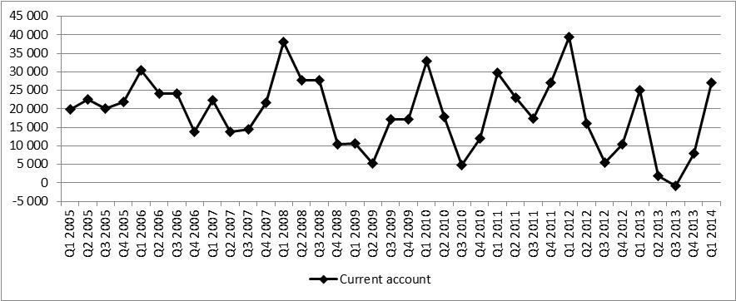
Current account of Russian Federation in millions of US dollars. Quarterly data for years 2005-1Q 2014
Source: Central Bank of Russian Federation, www.cbr.ru. 2014.

Slide 43
Capital account of Russian Federation in millions of US dollars for period from 2005 to 1Q 2014
Indicator | 2005 | 2008 | 2011 | 2013 | Q1 2014
Capital account | -12387 | -104 | 130 | -395 | -185
Gross acquisitions (debit) / disposals (credit) of nonproduced nonfinancial assets | -57 | -309 | 38 | -146 | -191
Capital transfers | -12331 | 205 | 92 | -249 | 6
General government | -12331 | 205 | 4 | -430 | -47
Financial corporations, nonfinancial corporations, households | 0 | 0 | 88 | 181 | 53
Source: Central Bank of Russian Federation, www.cbr.ru. 2014.

Slide 44
Financial account of Russian Federation in millions of US dollars for period from 2005 to 1Q 2014
Indicator | 2005 | 2008 | 2011 | 2013 | Q1 2014
Financial account | 66997 | 100781 | 88748 | 22906 | 21229
Direct investment | 2372 | -19120 | 11767 | 16058 | 5627
Portfolio investment | 11443 | 35691 | 15277 | 11011 | 17635
Financial derivatives | 233 | 1370 | 1394 | 346 | 623
Other investment | -8511 | 121765 | 47679 | 17567 | 24695
Reserve assets | 61461 | -38925 | 12630 | -22077 | -27351
Net errors and omissions | -5004 | -3051 | -8655 | -10840 | -5675
Source: Central Bank of Russian Federation, www.cbr.ru. 2014.

Slide 45
Balance of payments of Russian Federation in millions of US dollars for period from 2005 to 1Q 2014
Indicator | -2005- | -2008- | -2011- | -2013- | Q1 2014
Current account | 84389 | 103935 | 97274 | 34141 | 27089
Capital account | -12387 | -104 | 130 | -395 | -185
Financial account* | -66997 | -100781 | -88748 | -22906 | -21229
Net errors and omissions | -5004 | -3051 | -8655 | -10840 | -5675
Total** | 1 | -1 | 1 | 0 | 0
* Financial account is reported in previous tables with opposite sign. In fact it must be subtracted from the current account.
** Total sum not always equals to zero because of rounding errors.
Source: Central Bank of Russian Federation, www.cbr.ru. 2014.

Slide 46
3.2. The balance of payments transactions classification
The balance of payments is composed as a balance sheet using double-entry bookkeeping – every item involves two entries, a credit and a debit.
The credits record items lead to inflows of payments. Such items are associated with a greater demand for domestic currency or supply of foreign currency to the foreign exchange market.
The debits record items lead to payments outflows. These are associated with a greater supply of domestic currency or demand for foreign currency in the foreign exchange market.

Slide 47
Balance of Payments example operations: current account
Indicator | Credit ( + ) |  | Debit (-) |  | Net balance
Current account | 5075000 |  | 25000 |  | 5050000
Goods and services | 5050000 |  | 25000
Goods | 5000000 | (2)
 | 50000 | (5)
Services |  |  | 25000 | (4)
Primary income | 25000 |  | 0
Compensation of employees
Investment income | 25000 | (3)
Secondary income

Slide 48
Balance of Payments example operations: capital account
Capital account | 5025000 |  | 60075000 |  | -55050000
Gross acquisitions (debit) / disposals (credit) of nonproduced nonfinancial assets
Capital transfers |  |  | 50000 | (5)
General government
Financial corporations, nonfinancial corporations, households | 5000000 | (1) | 5000000 | (1)
 | 25000 | (4) | 5000000 | (2)
 |  |  | 25000 | (3)
 |  |  | 50000000 | (6)

Slide 49
Balance of Payments example operations: financial account
Financial account | 50000000 |  | 0 |  | 50000000
Direct investment
Portfolio investment
Financial derivatives
Other investment
Reserve assets | 50000000 |  |  | (6)
Net errors and omissions | 0 |  | 0
Total | 60100000 |  | 60100000 |  | 0

Slide 50
3.3. Balance of Payments Equilibrium and Adjustment
Balance of payments equilibrium exists when exports equal imports or credits equal debits on some particular subaccount.
In the case of flexible exchange rates balance of payments equilibrium is restored by the operation of the free market.
When the exchange rate is fixed the national currency can be overvalued or undervalued and the central banks must now finance the trade imbalance by international reserve flows.
Central banks use direct controls on international trade sometimes.

Slide 51
3.4. The Russian Foreign Debt
Indicator/Date | December 2011 | December 2012 | December 2013 | March 2014 | June 2014 (est.)
Total | 538,871 | 636,412 | 728,859 | 715,819 | 720,926
1. General Government | 34,719 | 54,403 | 61,738 | 53,629 | 54,638
1.1. Federal Government | 33,578 | 53,462 | 60,957 | 52,857 | 53,888
1.1.1 New Russian Debt | 31,068 | 51,334 | 58,944 | 50,853 | 52,000
1.1.2 Debt of the former USSR | 2,51 | 2,129 | 2,012 | 2,004 | 1,889
1.2. Local Government | 1,141 | 941 | 781 | 771 | 750
2. Central bank | 11,547 | 15,639 | 15,963 | 15,335 | 16,04
3. Banks | 162,764 | 201,567 | 214,394 | 214,022 | 206,531
4. Other sectors | 329,842 | 364,803 | 436,764 | 432,834 | 443,716
Source: The Central Bank of Russian Federation, www.cbr.ru. July 10, 2014.

Slide 52
Unit 4. Forward-looking Market Instruments
4.1. The currency forwards
4.2. The foreign exchange swap
4.3. The currency swaps
4.4. The foreign exchange futures
4.5. The foreign exchange options

Slide 53
4.1. The currency forwards
The currency forward is a contract in the foreign exchange market that locks in the exchange rate for the purchase or sale of a currency on a future date.
A currency forward represents a binding obligation, which means that the contract buyer or seller cannot walk away if the “locked in” rate eventually proves to be adverse. To compensate for the risk of non-delivery, financial institutions may require a deposit from retail investors or smaller firms with whom they do not have a business relationship.

Slide 54

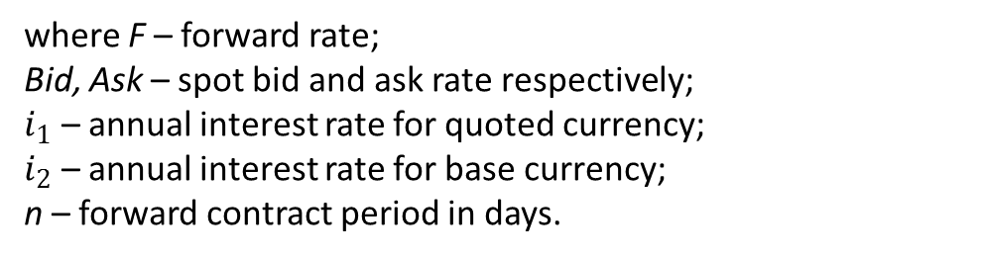
The mechanism for determining a currency forward rate is straightforward, and depends on interest rate differentials for the currency pair and is defined according to an equation
where F – forward rate;
Bid, Ask – spot bid and ask rate respectively;
$i_{1}$ – annual interest rate for quoted currency;
$i_{2}$ – annual interest rate for base currency;
n – forward contract period in days.

Slide 55
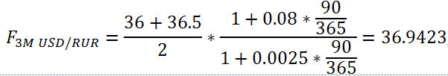
For example, assume a current spot rate for the Russian ruble of US$1 = RUR36.23 or USD/RUR=36.23, a one-year interest rate for Russian rubles of 8% (key rate held by the Central Bank of Russian Federation), and one-year interest rate for US dollars of 0.25%. Assume that USD/RUR bid and ask are 36.00 and 36.5 respectively. So, 3-months (3M) forward interest rate would be:

Slide 56
4.2. The foreign exchange swap
A foreign exchange swap is an arrangement where there is a simultaneous exchange of two currencies on a specific date at a rate agreed at the time of the contract, and a reverse exchange of the same two currencies at a date further in the future at a rate agreed at the time of the contract.
A foreign exchange swap consists of two legs:
1) a spot foreign exchange transaction, and;
2) a forward foreign exchange transaction.

Slide 57
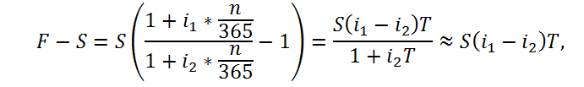
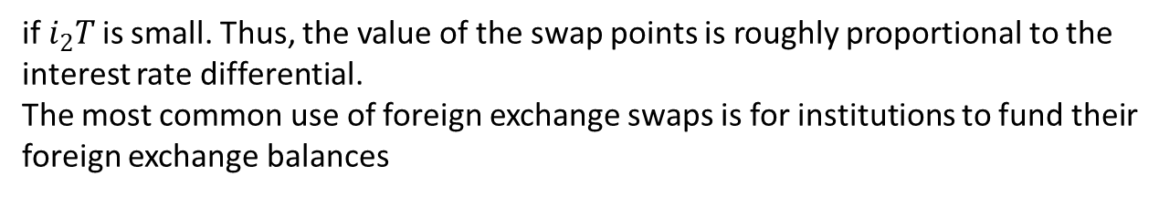
The forward points or swap points are quoted as the difference between forward and spot, F - S, and is expressed as the following
if $i_{2}T$is small. Thus, the value of the swap points is roughly proportional to the interest rate differential.
The most common use of foreign exchange swaps is for institutions to fund their foreign exchange balances

Slide 58
4.3. The currency swaps
A currency swap is a contract in which two counterparties exchange streams of interest payments in different currencies for an agreed period of time and then exchange principal amounts in the respective currencies at an agreed exchange rate at maturity.
Currency swaps allow firms to obtain long-term foreign currency financing at lower cost than they can by borrowing directly

Slide 59
Loan rates for two firms in different currencies
Firm | USD interest rate, % | EUR interest rate, %
Firm A | 10 | 7
Firm B | 9 | 8
Suppose, US firm has free access to loans from US banks, but can not have such favorable opportunities on Germany capital market.
Similarly, the German firm can have good loan conditions in the homeland, but far less favorable ones in the USA.
By currency swap agreement both firms can use comparative advantages of each other to reduce the cost of loan.

Slide 60
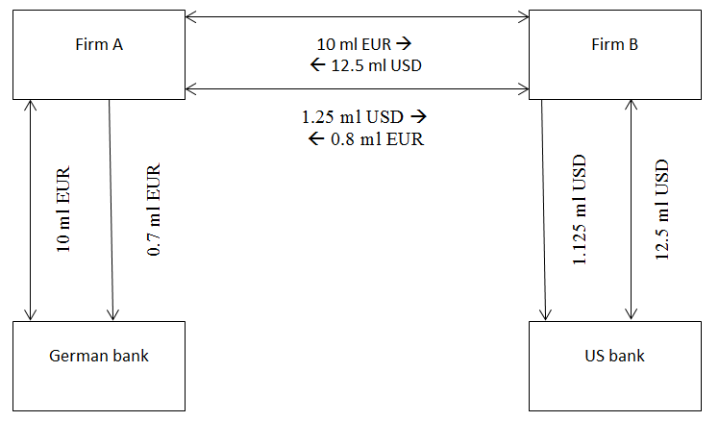
Cash flows of the two borrowers which has concluded currency swap agreement

Slide 61
Thus, both firms obtain the loans in necessary foreign currency at a lower rate, than it would be in case of the request for the credit directly in foreign bank. As a whole the Firm A saves on interest payments 0,8 ml – 0,7 ml = 0,1 ml EUR, and the Firm B saves on interest payments 1,25 ml – 1,125 ml = 0,125 ml USD.

Slide 62
4.4. The foreign exchange futures
Futures are similar to forward contracts. Each future contract has a fixed amount and pre-determined dates. The difference of futures from forwards consists in the following:
1. Futures trading is carried out on the open exchange market, and forwards – on interbank. Therefore dates of future contracts expiration are attached to certain dates. Futures contracts are standardized on expiration periods, volumes and terms of delivery. In case of forward contracts expiration periods and volumes of the transaction are determined by the mutual arrangement of the parties.
2. Futures are traded only on most liquid currency pairs. Forward contracts are traded almost on all currency pairs.

Slide 63
3. The futures market is available not only to big investors, but also small. The forward market is limited by that the minimum sum for the transaction amounts 500 thousand US dollars.
4. For about 95% futures trading volume come to an end with the conclusion of the opposite transaction, thus there is no real delivery of the currency. The parties receive only a difference between the initial price of the contract and the price existing in the day of the closing transaction. On the contrary, for about 95% forwards transactions come to an end with currency delivery.
5. Futures transactions cost are cheaper because of standardization.

Slide 64
4.5. The foreign exchange options
Foreign currency options are contracts that give a buyer the right to buy (call option) or sell (put option) currencies at a specified price within a specific period of time. The strike price is the price at which the owner of the contract has the right but not the obligation to transact.

Slide 65
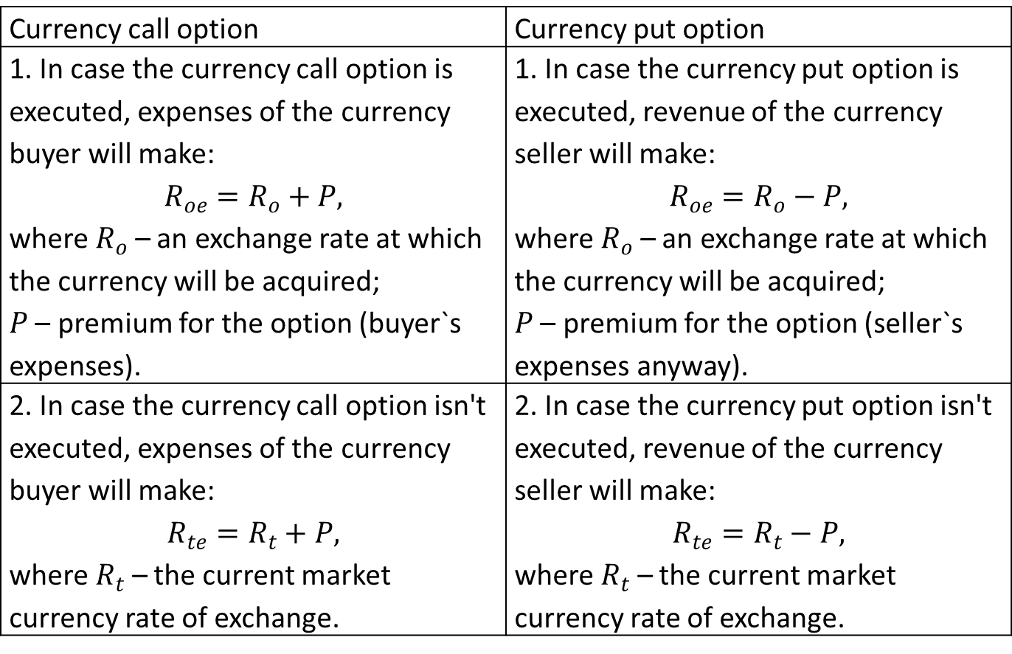
Comparison of currency call and put options
Currency call option | Currency put option
1. In case the currency call option is executed, expenses of the currency buyer will make: $$R_{oe}=R_{o}+P,$$ where $R_{o}$ – an exchange rate at which the currency will be acquired; $P$ – premium for the option (buyer`s expenses). | 1. In case the currency put option is executed, revenue of the currency seller will make: $$R_{oe}=R_{o}−P,$$ where $R_{o}$ – an exchange rate at which the currency will be acquired; $P$ – premium for the option (seller`s expenses anyway).
2. In case the currency call option isn't executed, expenses of the currency buyer will make: $$R_{te}=R_{t}+P,$$ where $R_{t}$ – the current market currency rate of exchange. | 2. In case the currency put option isn't executed, revenue of the currency seller will make: $$R_{te}=R_{t}−P,$$ where $R_{t}$ – the current market currency rate of exchange.

Slide 66
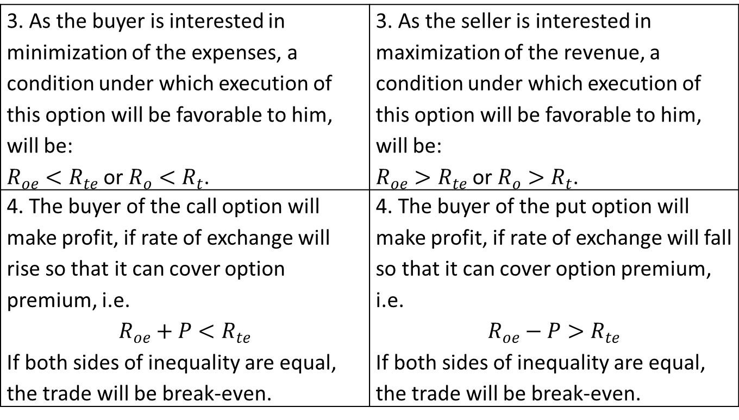
3. As the buyer is interested in minimization of the expenses, a condition under which execution of this option will be favorable to him, will be: $R_{oe}<R_{te}$ or $R_{o}<R_{t}$. | 3. As the seller is interested in maximization of the revenue, a condition under which execution of this option will be favorable to him, will be: $R_{oe}>R_{te}$ or $R_{o}>R_{t}$.
4. The buyer of the call option will make profit, if rate of exchange will rise so that it can cover option premium, i.e. $$R_{oe}+P<R_{te}$$ If both sides of inequality are equal, the trade will be break-even. | 4. The buyer of the put option will make profit, if rate of exchange will fall so that it can cover option premium, i.e. $$R_{oe}−P>R_{te}$$ If both sides of inequality are equal, the trade will be break-even.

Slide 67
For example, consider the firm in Russia that needs $1 million US dollars in 3 months. The firm decided to buy 3-months call option contract for USD/RUR.
Indicator | Bid | Ask
USD/RUR spot rate | 32.5 | 33.2
USD/RUR 3-months forward premium | 0.6 | 0.8
USD/RUR 3-month option premium | 0.2 | 0.2
It is required to define, whether the firm should realize an option if in three months the Bid/Ask rate of exchange for USD/RUR makes 32,80 and 33,40 respectively

Slide 68
Solution
If the firm execute the call option, its costs of dollar`s purchase will make
33,20 + 0,80 + 0,20 = 34,20.
If the firm doesn't execute the option, its expenses will make:
33,40 + 0,20 = 33,60.
Thus, option execution will be unprofitable to firm since increases its costs of dollar`s purchase per 0,60 rubles for one dollar.

Slide 69
Unit 5. The Eurocurrency Market
5.1. Reasons for Offshore Banking
5.2. Libor Interest Rate Spreads and Risk
5.3. Offshore Banking Practices

Slide 70
5.1. Reasons for Offshore Banking
Offshore banking units (OBUs) make loans in the Eurocurrency market when they accept deposits from foreign banks and other OBUs.
OBUs' activities are not restricted by local monetary authorities or governments, but they are prohibited from accepting domestic deposits.
Eurobanks enjoy lower reserve requirements, benefit from having no government -mandated interest rate controls, no deposit insurance, no government-mandated credit allocations, no restrictions on entry of new banks, and low taxes.

Slide 71
5.2. Libor Interest Rate Spreads and Risk
In the Eurodollar market, loan interest rates are usually quoted as percentage points above LIBOR (Intercontinental Exchange London Interbank Offered Rate).
LIBOR is a benchmark rate that some of the world’s leading banks charge each other for short-term loans.
There are a total of 150 Libor rates posted each day; interest rates are compiled for loans with 15 different maturities for each of 10 major currencies.
The most commonly quoted rate is the three-month U.S. dollar rate

Slide 72
Libor rates set the basis for a range of financial instruments such as:
home mortgages;
corporate loans;
credit card interest rates.

Slide 73
5.3. Offshore Banking Practices
Eurobanks are not able to create money as banks can in a domestic setting. Eurobanks are essentially intermediaries; they accept deposits and then loan these deposits.
Like all intermediaries, Eurobanks tend to borrow short term and lend long term.

Slide 74
External positions of banks in foreign currencies (assets in billions of US dollars)
 | Dec 2011 |  |  | Mar 2014
Country | All sectors | Nonbank sector |  | All sectors | Nonbank sector
 |  | In USD | In % |  | In USD | In %
All 44 countries | 17773 | 6982,7 | 39% | 17915 | 7382,3 | 41%
United Kingdom | 5102,3 | 2165,7 | 42% | 4549,9 | 2076,9 | 46%
Japan | 2219,8 | 1569,4 | 71% | 2475,8 | 1723,2 | 70%
Cayman Islands | 1543,5 | 390,4 | 25% | 1415,9 | 332 | 23%
Hong Kong SAR | 857,4 | 210,6 | 25% | 1099,9 | 290,7 | 26%
France | 803,5 | 243,2 | 30% | 995,5 | 400,2 | 40%
Switzerland | 677,7 | 142,9 | 21% | 775,2 | 223,9 | 29%
Singapore | 665 | 272,6 | 41% | 750,1 | 284,7 | 38%
Germany | 707,5 | 318,8 | 45% | 703,6 | 279,6 | 40%
Netherlands | 458,3 | 190,3 | 42% | 545,2 | 245,2 | 45%
Sweden | 355,5 | 83,5 | 23% | 415,1 | 101,9 | 25%
Canada | 378,2 | 127,4 | 34% | 387,7 | 156 | 40%
United States | 345,4 | 104 | 30% | 351,1 | 101,2 | 29%
Source: Bank for International Settlements. Detailed tables on BIS international banking statistics at end-March 2014. Basel, March, 2014.

Slide 75
Unit 6. Exchange Rates, Interest Rates, and Interest Parity
6.1. Interest Parity. Interest Rates and Inflation
6.2. The relation between Exchange Rates, Interest Rates, and Inflation

Slide 76
6.1. Interest Parity. Interest Rates and Inflation
Interest rate parity is a no-arbitrage condition on the market under which investors will be indifferent to interest rates available on bank deposits in two different currencies.
No-arbitrage condition exists when the market prices do not allow for profitable arbitrage.
This condition does not always hold and this create potential opportunities for riskless profits from arbitrage deals.
Two assumptions central to interest rate parity are capital mobility and perfect substitutability of domestic and foreign assets.

Slide 77
Two forms of interest rate parities:
uncovered interest rate parity (UIRP) exists when exposure to foreign exchange risk is uninhibited;
covered interest rate parity (CIRP) exists when a forward contract has been used to cover exchange rate risk

Slide 78
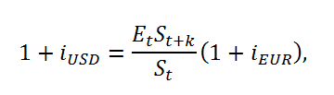
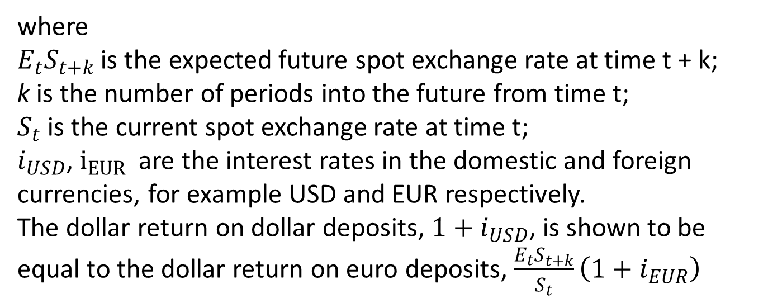
Uncovered interest rate parity (UIRP)
where
$E_{t}S_{t+k}$ is the expected future spot exchange rate at time t + k;
k is the number of periods into the future from time t;
$S_{t}$ is the current spot exchange rate at time t;
$i_{USD}$, $i_{EUR}$ are the interest rates in the domestic and foreign currencies, for example USD and EUR respectively.
The dollar return on dollar deposits, $1+i_{USD}$, is shown to be equal to the dollar return on euro deposits, $\frac{E_{t}S_{t+k}}{S_{t}}\left(1+i_{EUR}\right)$

Slide 79
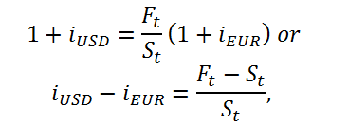
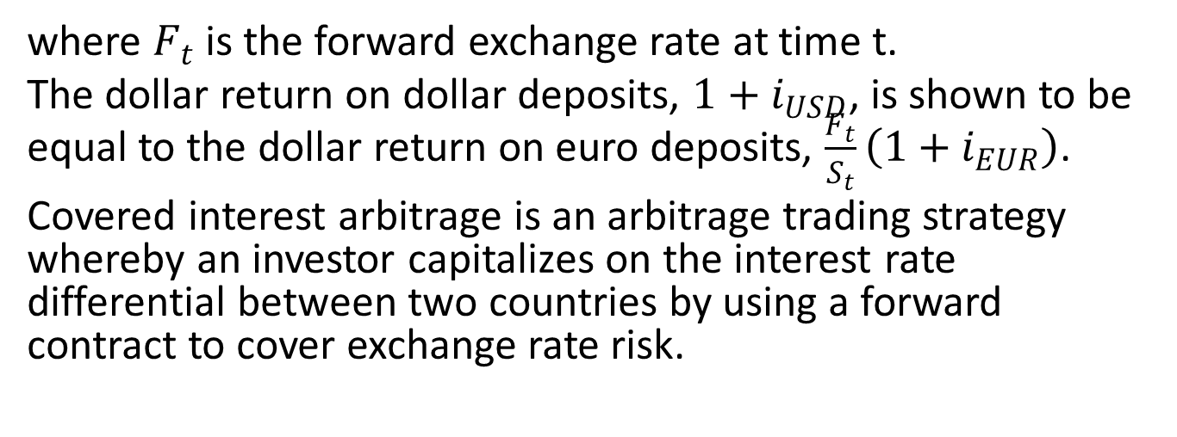
Covered interest rate parity (CIRP)
where $F_{t}$ is the forward exchange rate at time t.
The dollar return on dollar deposits, $1+i_{USD}$, is shown to be equal to the dollar return on euro deposits, $\frac{F_{t}}{S_{t}}\left(1+i_{EUR}\right)$.
Covered interest arbitrage is an arbitrage trading strategy whereby an investor capitalizes on the interest rate differential between two countries by using a forward contract to cover exchange rate risk.

Slide 80
6.2. The relation between Exchange Rates, Interest Rates, and Inflation
The nominal interest rate is the rate actually observed in the market.
The real rate is a concept that measures the return after adjusting for inflation.

Slide 81

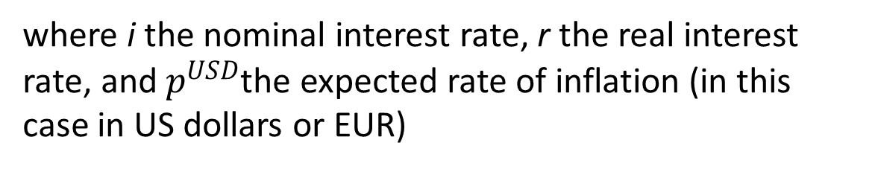
The Fisher effect
where i the nominal interest rate, r the real interest rate, and $p^{USD}$the expected rate of inflation (in this case in US dollars or EUR)

Slide 82

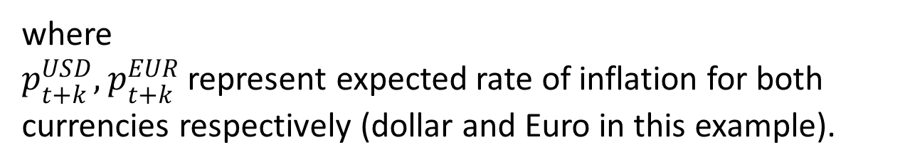
Real interest rate parity (RIRP)
where
$p_{t+k}^{USD},$ $p_{t+k}^{EUR}$ represent expected rate of inflation for both currencies respectively (dollar and Euro in this example).

Slide 83

The link between interest rates, inflation, and exchange rates
The interest differential is equal to expected rates of inflation differential and is also equal to the forward premium.
The parity condition suggests that real interest rates will equalize between countries and that capital mobility will result in capital flows that eliminate opportunities for arbitrage

Slide 84
Unit 7. Prices and Exchange Rates: Purchasing Power Parity
7.1. Absolute Purchasing Power Parity
7.2. The Big Mac Index
7.3. Relative Purchasing Power Parity
7.4. Overvalued and Undervalued Currencies
7.5. Real Exchange Rates

Slide 85

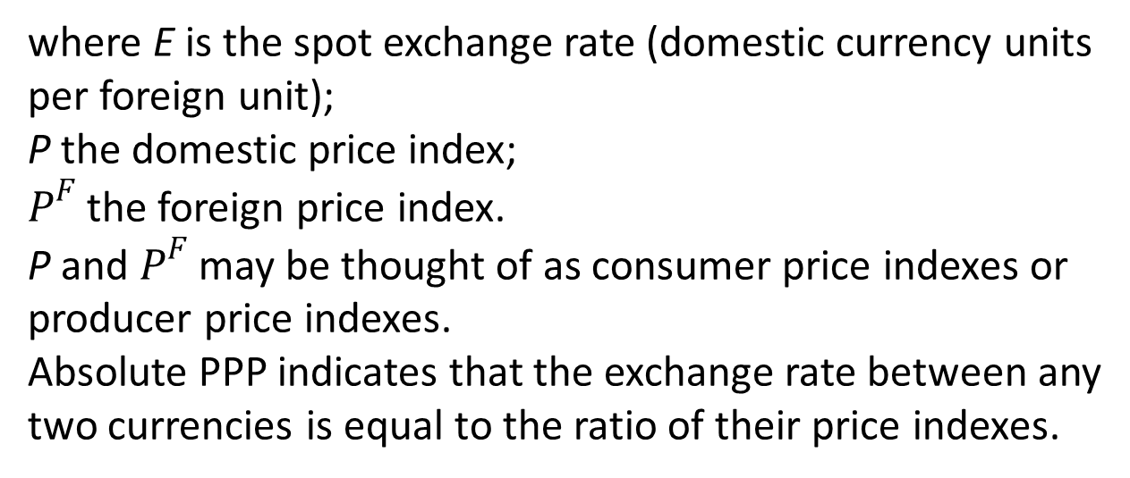
7.1. Absolute Purchasing Power Parity (PPP)
where E is the spot exchange rate (domestic currency units per foreign unit);
P the domestic price index;
$P^{F}$ the foreign price index.
P and $P^{F}$ may be thought of as consumer price indexes or producer price indexes.
Absolute PPP indicates that the exchange rate between any two currencies is equal to the ratio of their price indexes.

Slide 86
7.2. The Big Mac Index
The Big Mac Index is published by The Economist (http://www.economist.com) as an informal way of measuring the purchasing power parity (PPP) between two currencies and provides a test of the extent to which market exchange rates result in goods costing the same in different countries

Slide 87
Sources: McDonald`s, The Economist. July 23, 2014.

Slide 88

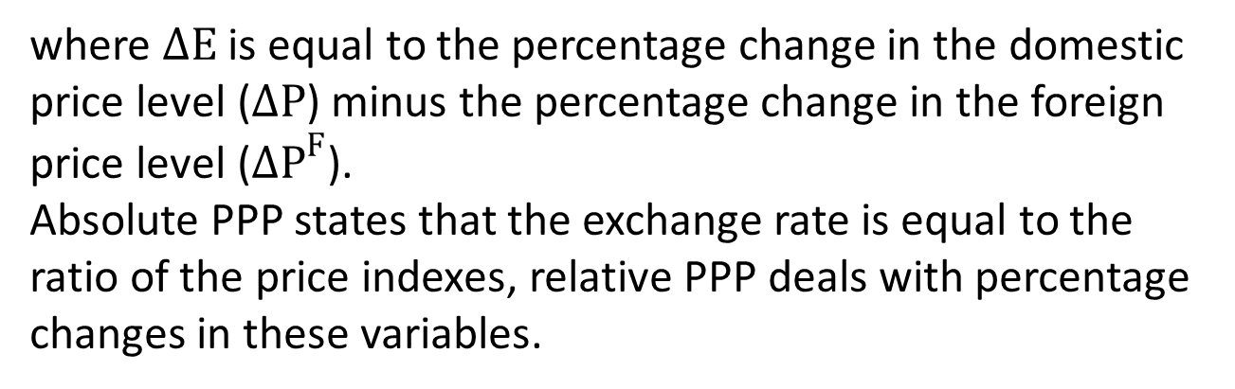
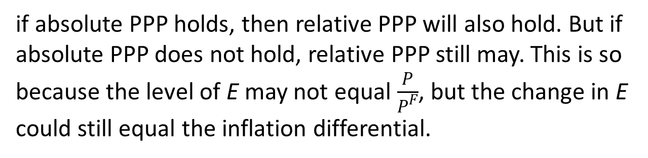
7.3. Relative Purchasing Power Parity
where $∆E$ is equal to the percentage change in the domestic price level ($∆P$) minus the percentage change in the foreign price level (${∆P}^{F}$).
Absolute PPP states that the exchange rate is equal to the ratio of the price indexes, relative PPP deals with percentage changes in these variables.
if absolute PPP holds, then relative PPP will also hold. But if absolute PPP does not hold, relative PPP still may. This is so because the level of E may not equal $\frac{P}{P^{F}}$, but the change in E could still equal the inflation differential.

Slide 89
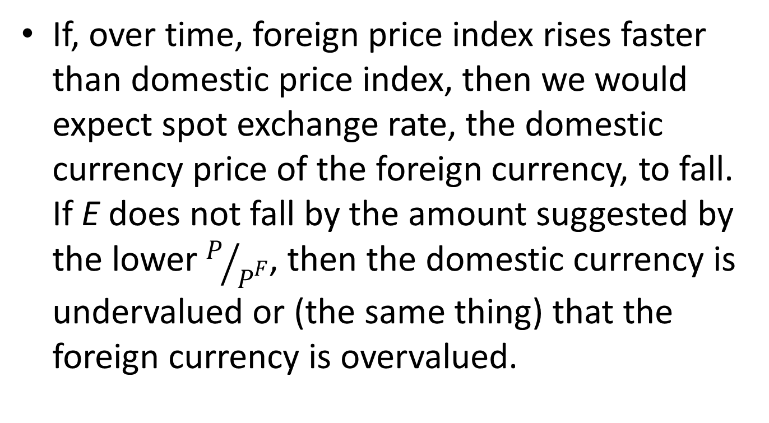
7.4. Overvalued and Undervalued Currencies
If, over time, foreign price index rises faster than domestic price index, then we would expect spot exchange rate, the domestic currency price of the foreign currency, to fall. If E does not fall by the amount suggested by the lower $P/{P^{F}}$, then the domestic currency is undervalued or (the same thing) that the foreign currency is overvalued.

Slide 90
The implied PPP exchange rate
The implied PPP exchange rate measures the values the exchange rate would take if the percentage change in the exchange rate equaled the inflation differential between two countries.
If the spot exchange rate is greater than the implied PPP exchange rate than the currency is supposed to be overvalued. Otherwise, the currency would be undervalued.

Slide 91
7.5. Real Exchange Rates
The real interest rate is the rate of interest is expected rate to receive after adjustment for inflation.
The real exchange rate is the purchasing power of a currency relative to another at current exchange rates and prices.

Slide 92
Unit 8. Foreign Exchange Risk and Forecasting
8.1. Types of Foreign Exchange Risk
8.2. Foreign Exchange Risk Premium
8.3. Foreign Exchange Forecasting

Slide 93
8.1. Types of Foreign Exchange Risk
1. Translation exposure.
2. Transaction exposure.
3. Economic exposure.

Slide 94
Translation exposure
This is also known as accounting exposure. It is the difference between foreign currency denominated assets and foreign currency denominated liabilities

Slide 95
Transaction exposure
This is exposure resulting from the uncertain domestic currency value of a foreign currency denominated transaction to be completed at some future date

Slide 96
Economic exposure
This is exposure of the firm’s value to changes in exchange rates. If the value of the firm is measured as the present value of future after-tax cash flows, then economic exposure is concerned with the sensitivity of the real domestic currency value of long-term cash flows to exchange rate changes.

Slide 97
Foreign exchange risk may be hedged or eliminated by the following strategies
1. Trading in forward, futures, or options markets.
2. Invoicing in the domestic currency.
3. Speeding (slowing) payments of currencies expected to appreciate (depreciate).
4. Speeding (slowing) collection of currencies expected to depreciate (appreciate).

Slide 98
8.2. Foreign Exchange Risk Premium
The forward exchange rate may serve as a predictor of future spot exchange rates. We may question whether the forward rate should be equal to the expected future spot rate.
The effective return differential is equal to the percentage difference between the forward and expected future spot exchange rate

Slide 99

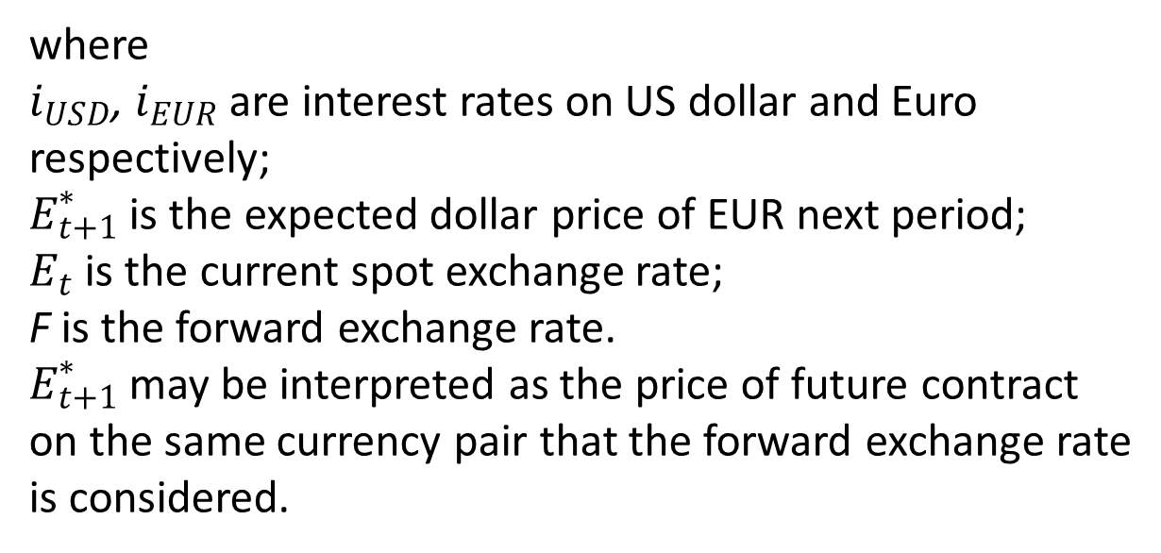
The effective return differential
where
$i_{USD}$, $i_{EUR}$ are interest rates on US dollar and Euro respectively;
$E_{t+1}^{∗}$ is the expected dollar price of EUR next period;
$E_{t}$ is the current spot exchange rate;
F is the forward exchange rate.
$E_{t+1}^{∗}$ may be interpreted as the price of future contract on the same currency pair that the forward exchange rate is considered.

Slide 100

The risk premium in the forward exchange market
If the effective return differential is zero, then there would appear to be no risk premium. If the effective return differential is positive, then there is a positive risk premium on the domestic currency.

Slide 101
8.3. Foreign Exchange Forecasting
A fundamental model forecasts exchange rates based on variables that are believed to be important determinants of exchange rates.
A technical trading model uses the past history of exchange rates to predict future movements. Technical traders use charts or diagrams depicting the time path of an exchange rate which they believe will reverse or accelerate the trend.

Slide 102
Unit 9. Financial Management of the Multinational Firm
9.1. Financial Control
9.2. Cash Management.
9.3. Letters of Credit.
9.4. Intrafirm Transfers
9.5. Capital Budgeting

Slide 103
9.1. Financial Control
The multinational firms carry currency exchange risk and some other risks in which domestic companies may never have been involved.
Typical control systems are based on setting standards with regard to sales, profits, inventory, or other specific variables and then examining financial statements and reports to evaluate the achievement of such goals.

Slide 104
9.2. Cash Management
Cash management involves using the firm’s cash as efficiently as possible.
Cash is the most liquid asset.
Since cash earns no interest, the firm has a strong incentive to minimize its holdings of cash.

Slide 105
Multinational cash management
Centralization of cash management
Netting

Slide 106
9.3. Letters of Credit
A letter of credit (LOC) is a written instrument issued by a bank at the request of an importer that obligates the bank to pay a specific amount of money to an exporter.
Following condition are specified in the contract:
payment time;
documents to be presented by the exporter prior to payment;
a bill of lading (a detailed list of the content that is shipped, and can be used to identify missing or damaged items).

Slide 107
9.4. Intrafirm Transfers
The price that one subsidiary charges another subsidiary for internal goods transfers is called a transfer price.
The transfer prices can be a sensitive internal corporate issue because it helps to determine how total firm profits are allocated across divisions.
Governments are also interested in transfer pricing since the prices at which goods are transferred will determine tariff and tax revenues.
The parent firm always has an incentive to minimize taxes by pricing transfers in order to keep profits low in high-tax countries and by shifting profits to subsidiaries in low-tax countries.

Slide 108
9.5. Capital Budgeting
Capital budgeting refers to the evaluation of prospective investment alternatives and the commitment of funds to preferred projects.
Long-term commitments of funds extending beyond one year are called capital expenditures
Foreign projects involve foreign exchange risk, political risk, and foreign tax regulations.
Several effects should be included in project valuation
depreciation charges;
credit terms extended to the subsidiary by a government or official agency;
deferred or reduced taxes given as incentive to undertake the expenditure.

Slide 109
Unit 10. International Portfolio Investment
10.1. Portfolio Diversification
10.2. Depositary receipts
10.3. The Globalization of Equity Markets

Slide 110
10.1. Portfolio Diversification
Diversification means reducing non-systematic risk by investing in a variety of assets.
The variance that can be eliminated through diversification is called nonsystematic risk; this is the risk that is unique to a particular firm or industry. Systematic risk is common to all firms and remains even in diversified portfolios.
International diversification:
More wide than domestic.
By investing across countries, we eliminate part of the cyclical fluctuation in our portfolio that would arise from the domestic business cycle.

Slide 111
10.2. Depositary receipts
A depositary receipt is a negotiable financial instrument issued by a bank to represent a foreign company's publicly traded securities.
When the depositary bank is in the U.S., the instruments are known as American Depositary Receipts (ADRs). European banks issue European depository receipts (EDRs), and other banks issue global depository receipts (GDRs).

Slide 112
10.3. The Globalization of Equity Markets
A segmented market is one in which foreign investors are not allowed to buy domestic stocks and domestic investors are not allowed to buy foreign stocks.
Part of the process of the globalization of world economies is the liberalization of stock market restrictions to open markets to the world.

Slide 113
Emerging economies have the following signs
Attempting to order its national accounts, privatize state companies, and deregulate economic activity.
Stabilizing its political system, moving from more autocratic regimes to liberal, democratic rules; increasing public interest in solving the most pressing social problems.
Rapidly dismantling the barriers to foreign trade and investment, thereby quickly increasing its share in the world economy. Being flooded by foreign capital, hard technologies, and new, advanced managerial practices, as multinational corporations (MNCs) enter its territory.

Slide 114
Experiencing a profound change in the structure of entire industries and individual companies, pushing firms to approach international standards of competitiveness.
Growing rate of activity in mergers and acquisitions (M8cAs), joint ventures, and the establishment of wholly owned subsidiaries to extract value from the productivity gaps existing between the emerging economy and other more developed markets.
Boasting domestic stock market, which beckons international financial investors.
Expanding influence to other neighboring economies, which, in turn, start to open to the world.

Slide 115
Unit 11. Direct Foreign Investment and International Lending
11.1. Direct Foreign Investment
11.2. Capital Flight
11.3. International Lending and Crisis
11.4. IMF Conditionality
11.5. Country Risk Analysis

Slide 116
11.1. Direct Foreign Investment
Direct foreign investment is the spending by a domestic firm to establish foreign operating units.
In the balance of payments, direct investment is distinguished from portfolio investment solely on the basis of percentage of ownership.
Capital flows are designated as direct investment when a foreign entity owns 10 percent or more of a firm.

Slide 117
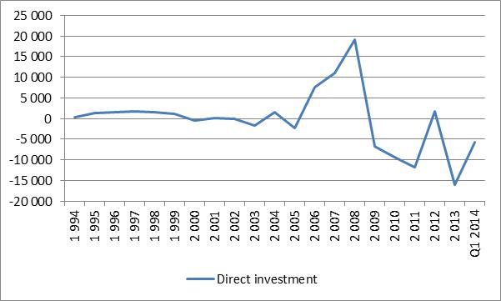
Direct investment in Russian Federation in millions of US dollars for years 1994-1Q 2014
Source: Central Bank of Russian Federation, www.cbr.ru. 2014

Slide 118
11.2. Capital Flight
When the risk of doing business in a country rises sharply or the expected return falls, there are probable large outflows of investment funds so that the country experiences massive capital account deficits.
The change in the risk-return relationship that gives rise to capital flight may be the result of political or financial crisis, tightening capital controls, tax increases, or fear of a domestic currency devaluation.
On the other side, a large capital inflow in a short period of time can lead to an appreciation of the recipient country’s currency. This appreciation may reduce the competitiveness of the nation’s export industries and cause a fall in output and rise in unemployment in these industries.

Slide 119
11.3. International Lending and Crisis
Warning indicators of potential future crises:
Fixed exchange rates.
Falling international reserves.
Lack of transparency.

Slide 120
11.4. IMF Conditionality
The IMF not only “bail out” commercial bank or government creditors.
The IMF requires borrowers to adjust their economic policies to reduce balance of payments.
The IMF has been criticized for imposing conditions that restrict economic growth and lower living standards in borrowing countries.
The typical conditionality involves reducing government spending, raising taxes, and restricting money growth.

Slide 121
11.5. Country Risk Analysis
the evaluation of the overall political and financial situation in a country and the extent to which these conditions may affect the country’s ability to repay its debts.
There are qualitative and quantitative factors that affect country risk premium

Slide 122
Qualitative factors that affect country risk premium
1. Splits between different language, ethnic, and religious groups that threaten to undermine stability.
2. Extreme nationalism and aversion to foreigners that may lead to preferential treatment of local interests and nationalization of foreign holdings.
3. Unfavorable social conditions, including extremes of wealth.
4. Conflicts in society evidenced by frequency of demonstrations, violence, and guerrilla war.
5. The strength and organization of radical groups.

Slide 123
Quantitative factors that affect country risk premium
1. External debt.
2. International reserve holdings.
3. Exports.
4. Economic growth.

Slide 124
Unit 12. Determinants of the Balance of Trade
12.1. Elasticities Approach to the Balance of Trade
12.2. The Marshall-Lerner Condition
12.3. The Evidence from Devaluations
12.4. Absorption Approach to the Balance of Trade

Slide 125
12.1. Elasticities Approach to the Balance of Trade
Elasticity measures the responsiveness of quantity to changes in price
When demand or supply is elastic, it means that quantity demanded or supplied will be relatively responsive to the change in price. An inelastic demand or supply indicates that quantity is relatively unresponsive to price changes.

Slide 126

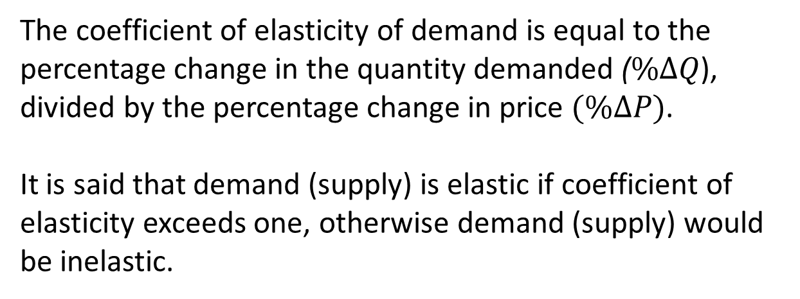
The coefficient of elasticity of demand
The coefficient of elasticity of demand is equal to the percentage change in the quantity demanded ($\%∆Q$), divided by the percentage change in price $(\%∆P)$.
It is said that demand (supply) is elastic if coefficient of elasticity exceeds one, otherwise demand (supply) would be inelastic.

Slide 127
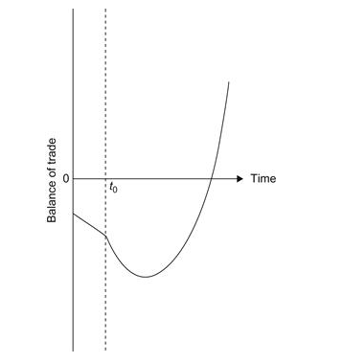
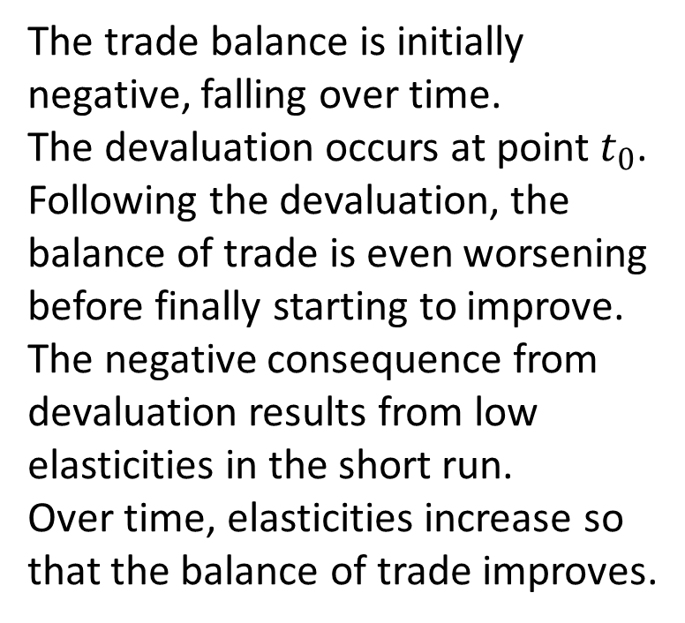
The J-curve effect
The trade balance is initially negative, falling over time.
The devaluation occurs at point $t_{0}$.
Following the devaluation, the balance of trade is even worsening before finally starting to improve.
The negative consequence from devaluation results from low elasticities in the short run.
Over time, elasticities increase so that the balance of trade improves.

Slide 128

The currency contract period
During this period the traders have limited changes in the quantities in response to the new set of prices (after devaluation), but over time the response becomes complete.

Slide 129
Russian Trade Balance Effects During Pass-Through Period Following a Devaluation
Russian exports | Russian imports
 | Inelastic supply | Inelastic demand
Inelastic supply | 1. Exports increase Imports constant Balance of trade increases | 2. Exports increase Imports increase Initial surplus: balance of trade increase Initial deficit: balance of trade decreases
Inelastic demand | 3. Exports constant Imports constant Balance of trade constant | 4. Exports constant Imports increase Balance of trade decreases

Slide 130
12.2. The Marshall-Lerner Condition
In case when the demand elasticity for imports is perfectly inelastic and the demand for exports is also perfectly inelastic, the trade balance will not improve after devaluation.
The Marshall-Lerner condition states that to improve balance of trade the absolute value of the sum of the elasticities of the demand for imports and the demand for exports has to be greater than unity.

Slide 131
12.3. The Evidence from Devaluations
In countries where the ratio of capital to labor employed is low, devaluations are much more likely to result in export expansion and faster economic growth.
In countries where the capital/ labor ratio is high, devaluations will tend to have little if any expansionary influence on exports and economic growth.

Slide 132
12.4. Absorption Approach to the Balance of Trade
The absorption approach to the balance of trade is a theory that emphasizes how domestic spending on domestic goods changes relative to domestic output

Slide 133


where C is consumption ; I, investment; G, government spending; X, exports; and M, imports. We can define absorption, A, as being equal to C + I + G, and net exports as (X − M). So,

Slide 134
At the full employment, all resources are being used so that the only way for net exports to increase is to have absorption fall.
On the other hand, with unemployment, Y is not at its maximum possible value, and thus Y could increase due to increases in exports, X, without changing the domestic absorption, A.

Slide 135
Absorption and IMF conditionality
The absorption approach is generally concerned with the effects of a devaluation on the trade balance.
At the full employment level, it will not be possible to produce more goods and services. So devaluation will not improve trade balance and cause only inflation.
The typical IMF conditionality involves reducing government spending, raising taxes, and restricting money growth.

Slide 136
Unit 13. The IS-LM-BP Approach
13.1. IS-LM-BP model
13.2. Monetary Policy under Fixed Exchange Rates
13.3. Fiscal Policy under Fixed Exchange Rates
13.4. Monetary Policy under Floating Exchange Rates
13.5. Fiscal Policy under Floating Exchange Rates

Slide 137
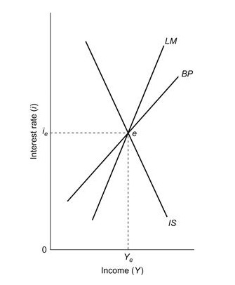
13.1. IS-LM-BP model
Macroeconomic equilibrium

Slide 138
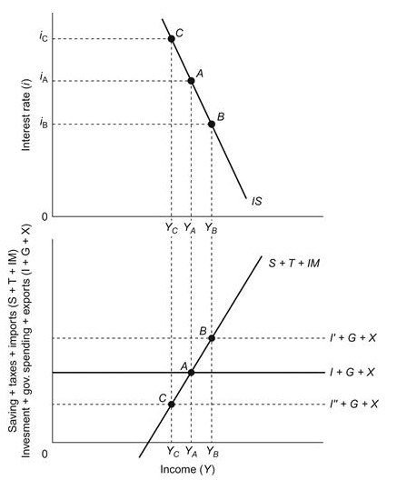
Goods market equilibrium. Investment-Saving (IS) curve

Slide 139
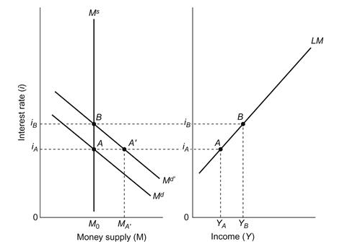
Money market equilibrium. Liquidity preference and Money supply (LM) curve

Slide 140
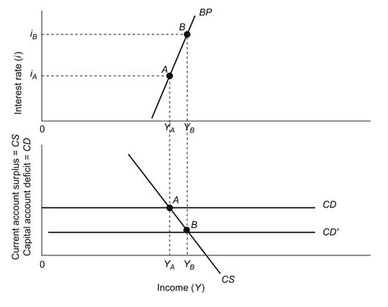
Balance of payments equilibrium. Balance of Payment (BP) curve

Slide 141
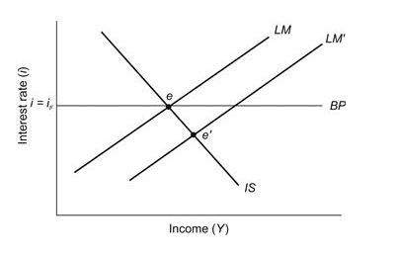
13.2. Monetary Policy under Fixed Exchange Rates
With fixed exchange rates, a country cannot conduct an independent monetary policy to change domestic income.

Slide 142
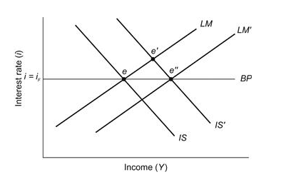
13.3. Fiscal Policy under Fixed Exchange Rates
Fiscal expansion with fixed exchange rates has effect on income and can be used to stimulate the domestic economy.

Slide 143
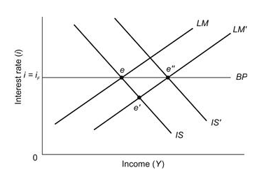
13.4. Monetary Policy under Floating Exchange Rates
With floating exchange rates, monetary policy is effective in changing domestic income

Slide 144
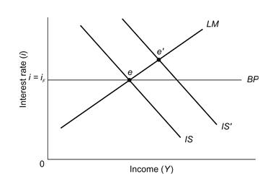
13.5. Fiscal Policy under Floating Exchange Rates
With floating exchange rates, fiscal policy is ineffective in shifting the level of income. It will cause only the appreciation of domestic currency.

